Slide 1
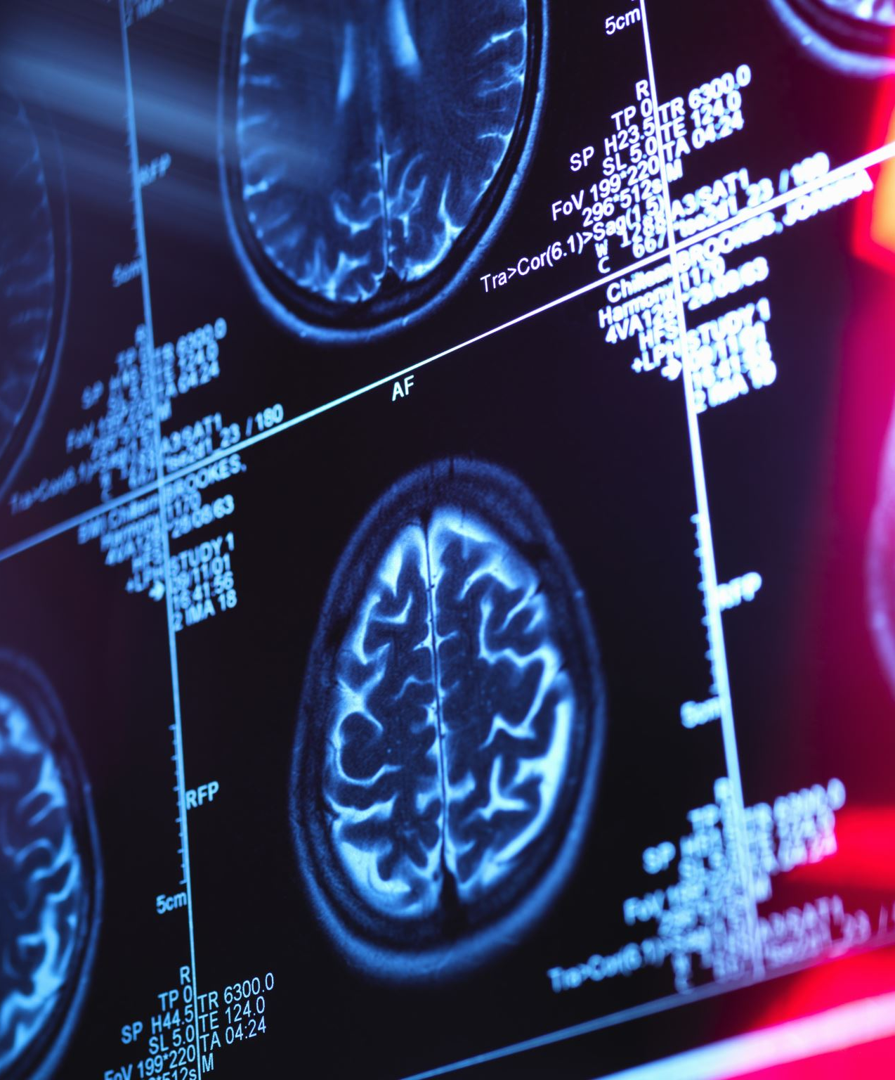
Explainable Machine Learning (XAI) for Anomaly Detection in Medical IoT Sensor Data
Bridging the Interpretability Gap in Clinical Monitoring
Joslin Gadde Student ID: 20076078
Supervisor : Salem Serif

Slide 2
Problem Statement & Motivation
The Problem
mIoT produces high-velocity physiological data
Difficult to distinguish:
medical emergency
sensor malfunction
Existing AI systems are “black-box”
Clinical Consequence
Alarm Fatigue
Reduced clinician trust
Delayed intervention
Sensor Data
Black Box AI
Unclear Alert
Clinician Confusion
Notes:
So the problem statement for this research project is that medical IOT sensors create high volume data which are significantly frequent alerts leading to alarm fatigue and lack of clinical trust for this. We use a machine learning models not only to detetct anomalies from censor data outputs which often reads binary outputs like normal and abnormal detections without explaining why an alert was triggered so a solution this research works as an explainable framework using an auto coder SHAP and lime to foster trust and distinguish between device which is technical or a patient health which is medical anomalous.

Slide 3
Literature Review & Research Gap
Existing Gap
Most studies:
focus on anomaly detection only
ignore explanation reliability
lack distinction between:
physiological anomaly
sensor fault
Feature | SHAP (Shapley Additive Explanations) | LIME (Local Interpretable Model-agnostic Explanations) | Grad-CAM (Gradient-weighted Class Activation Mapping)
Explanation Type | Local & Global | Primarily Local | Visual/Saliency Maps
Model Compatibility | Model-Agnostic (works with any model) | Model-Agnostic | Model-Specific (CNNs/Deep Learning only)
Mathematical Basis | Cooperative Game Theory (Shapley Values) | Local Linear Surrogates | Gradients of target concept
Consistency | High: Ensures fair contribution of each feature. | Lower: Can produce different explanations for similar data points. | Medium: Can be noisy or "smear" over irrelevant areas.
Computational Cost | High (can be slow for real-time IoT) | Fast/Efficient | Very Fast (calculated during backprop)
Best Use Case | Precision diagnostics where "fair" feature attribution is required. | Quick, rough interpretations of tabular data. | Image-based medical data (e.g., MRI/X-ray anomaly localization).
Proposed Solution:
Autoencoder + SHAP + Clinical Decision Layer(future work)
Notes:
Most current research focuses on the Accuracy of detection (e.g., "Our model is 99% accurate"). High accuracy is useless in a hospital if a doctor doesn't know why an alarm is ringing. Existing studies treat mIoT sensors as simple data points, ignoring the clinical need for "Feature Attribution."In a real mIoT device (like a smart pacemaker), an anomaly could be a heart attack (Medical) OR a sensor malfunction/hack (Technical). Most papers only look at one or the other. project analyzes cross-layer data. By using SHAP, your model can tell if an anomaly is "Physiological" (coordinated changes in HR and $SpO_2$) or "Systemic" (erratic spikes in device-layer metadata).

Slide 4
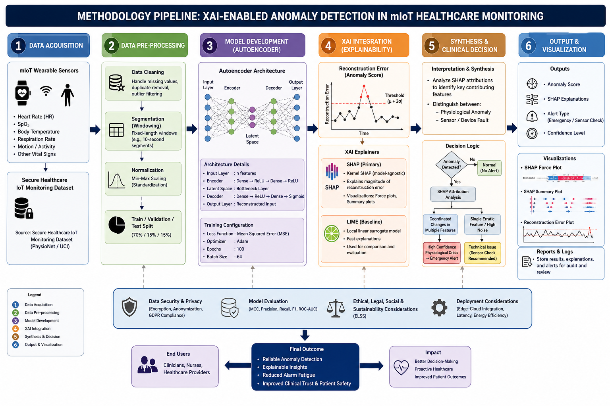
Research Methodology
Stages
Data Acquisition
Preprocessing
Model Development
XAI Integration
Synthesis
Notes:
For this I have designed and implemented a methodology with the technical framework

Slide 5
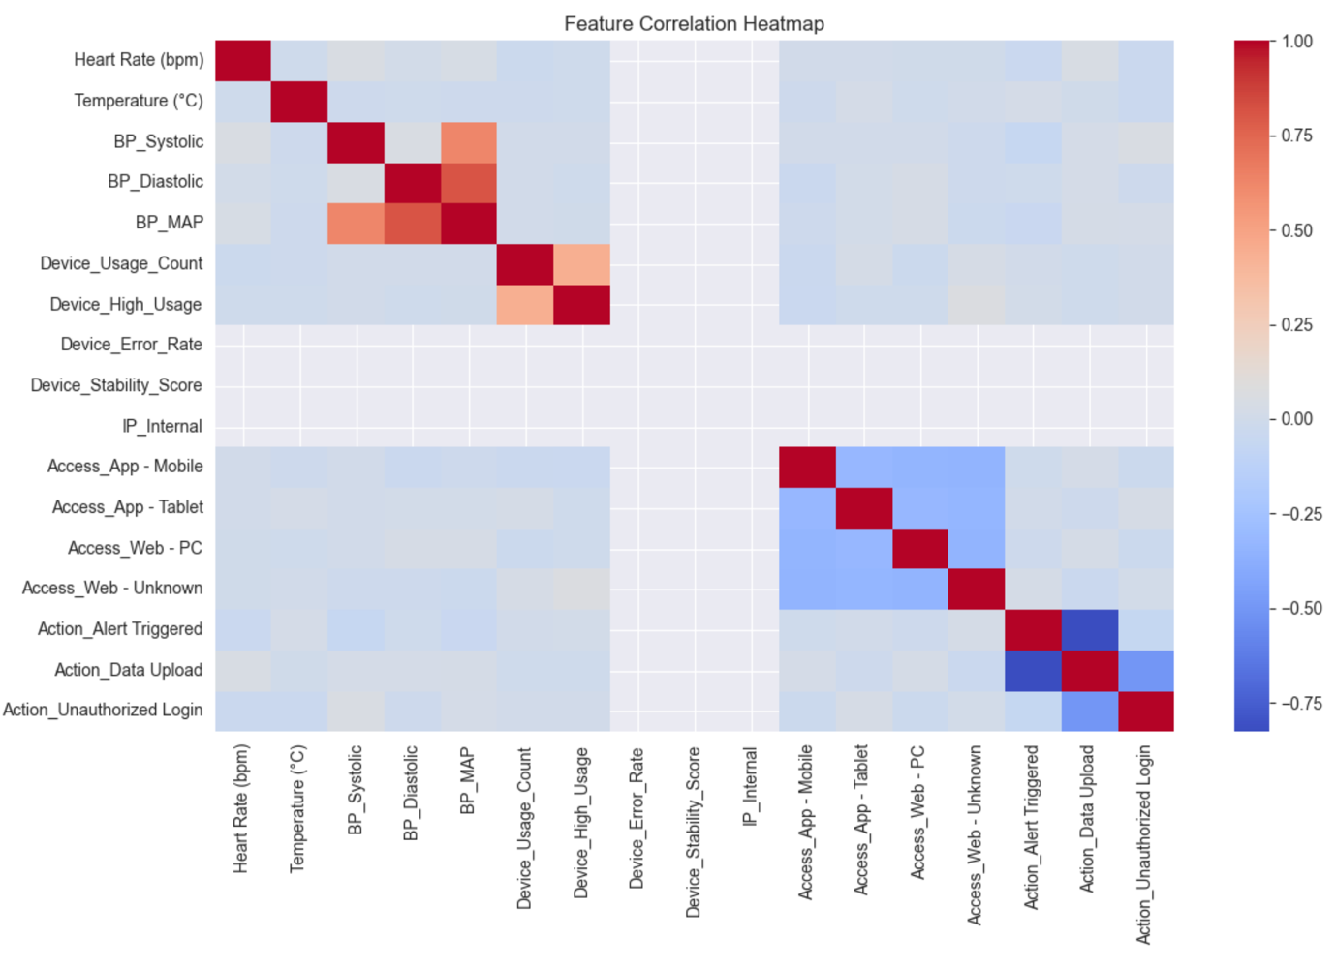
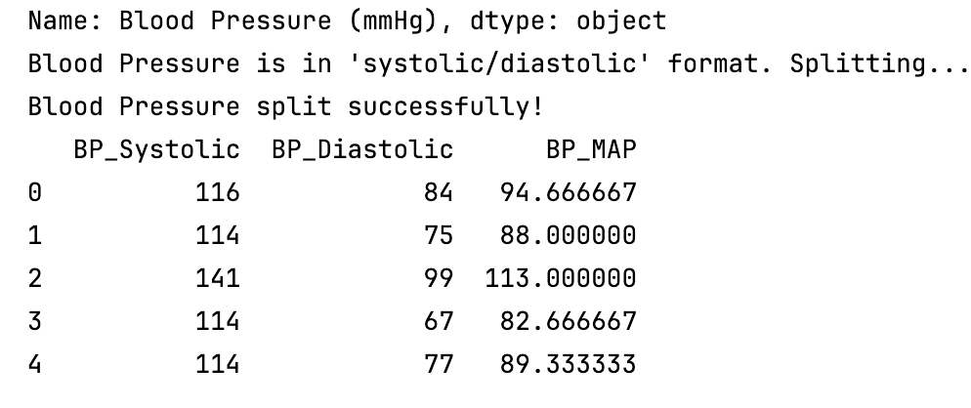
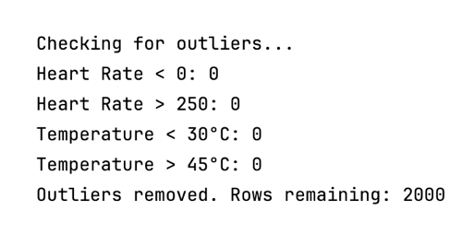

Dataset & Data Preprocessing
Dataset
Secure Healthcare IoT Dataset
~2000 records
physiological + sensor features
Preprocessing Techniques
Missing value handling
Windowing (10-second segments)
Z-score normalization
Mean Arterial Pressure:
$MAP=\frac{1}{3}BP_{systolic}+\frac{2}{3}BP_{diastolic}$
Notes:
well starting off with the secondary data I said from Kegle with 200 entries and 202,000 data attributes that has the vital readings from advertence and also a parallel device ratings device/device charge is an device ID and I have done the data processing which has included eliminating no value entries and duplicate values to maintain accuracy and also passing data types for redundancy and removing the outliers factors
For feature engineering I have taken clinical patient level attributes and device level attributes and performed network featuring and also a passing techniques for a few attribute such as blood pressure using formulas like Z scores which results gives a main atrial pressure. MAP that performs on both BP systolic and BP diastolic which in return check force outliers in heart rate temperatures and remove them and in final we have arose remaining of 2000 in which we will split them train them with the models that we have selected in final

Slide 6
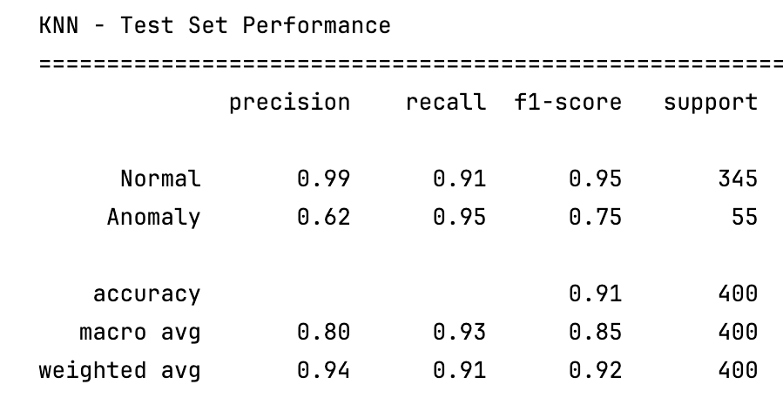
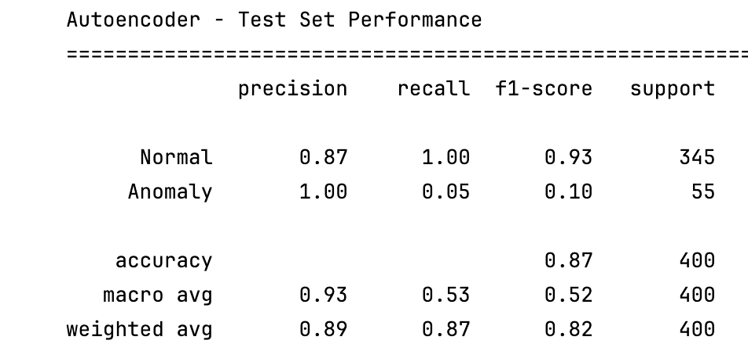
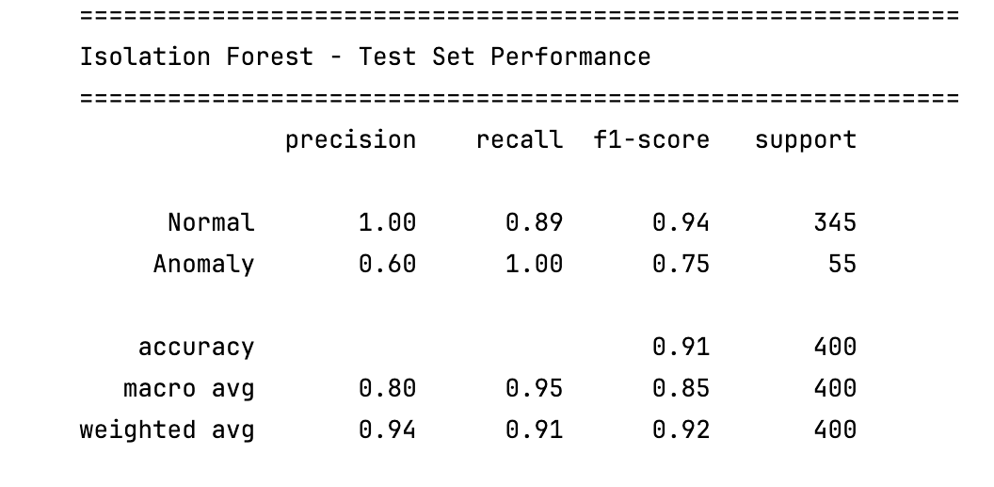
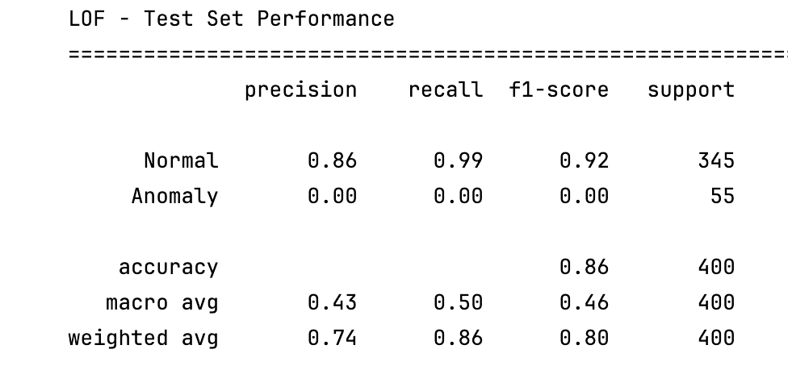
Model Development
Input
Encoder
Latent Space
Decoder
Reconstruction Error
Model | Type | Weakness
Isolation Forest | Tree-based | Weak temporal learning
KNN | Distance-based | Sensitive to noise
LOF | Density-based | High-dimensional issues
Autoencoder | Deep Learning | Black-box
Why Autoencoder?
Learns non-linear patterns
Strong reconstruction capability
Better for “normal behaviour learning”
Notes:
And for this research I have selected four distinguish models that is isolation forest Canon local outlier factors and a deep learning model which is auto” after implementing these models and validating them against matrix that were popularly used for these kind of experiments such as accuracy precision recall and scoring , which in return gives auto encoder anomalous were identified by high reconstruction error

Slide 7
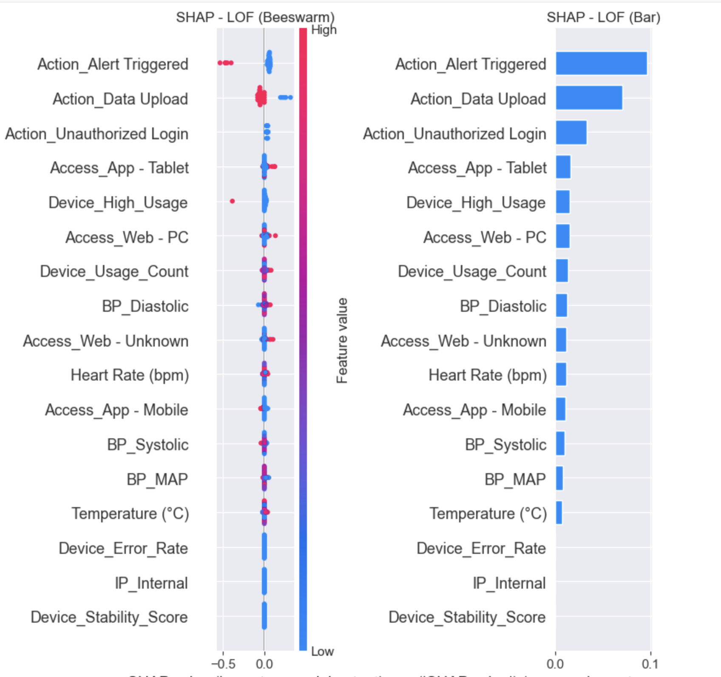
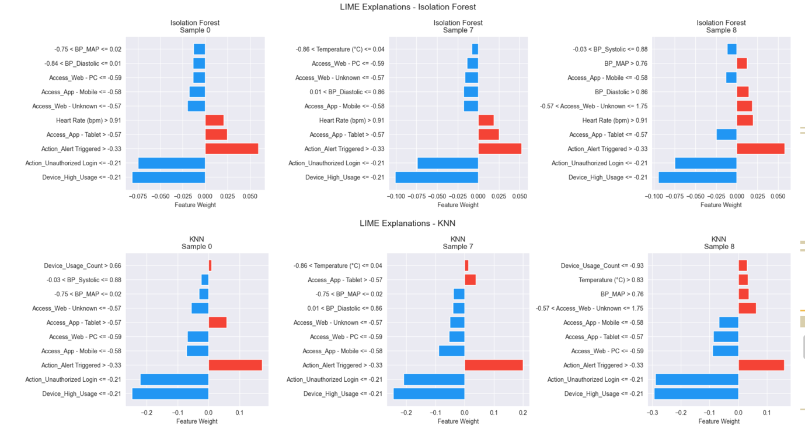
XAI Integration
SHAP | LIME
Stable | Unstable
Accurate | Fast
Expensive | Lightweight
LIME
local surrogate model
fast
unstable
SHAP
Kernel SHAP
fair attribution
explains reconstruction error
Notes:
Coming to the core point of the research and major contribution for this particular project the explainability AI integration for an detection for this I have used SHAP and lime where SHAP access is a primary method which provides global and local feature importance and in my testing it consistently identified heart rate and SPO to a stop drivers clinical anomalous which is obvious and for lime integration which is comparative a baseline popularly used for instance level explanations to summarise SHAP offers higher consistency and fairness in future attribution which is critical for precision diagnostics as lime is faster but can be unstable sometimes producing different explanations for similar data points

Slide 8
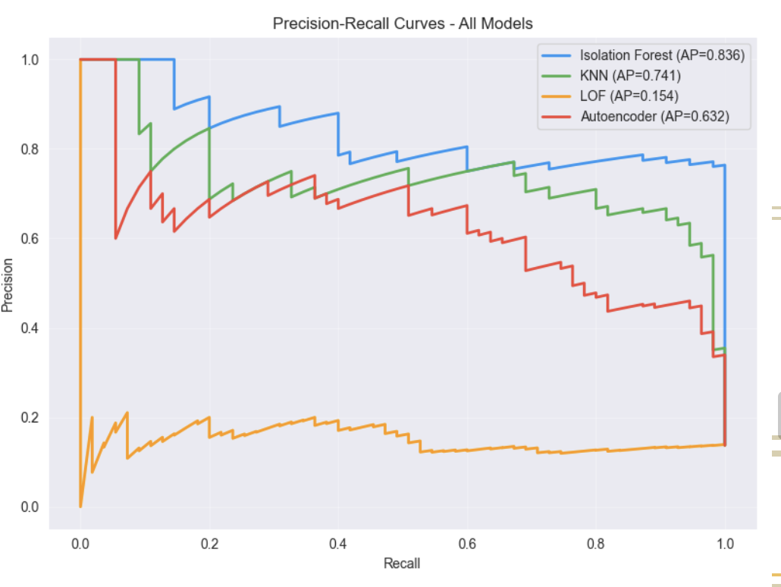
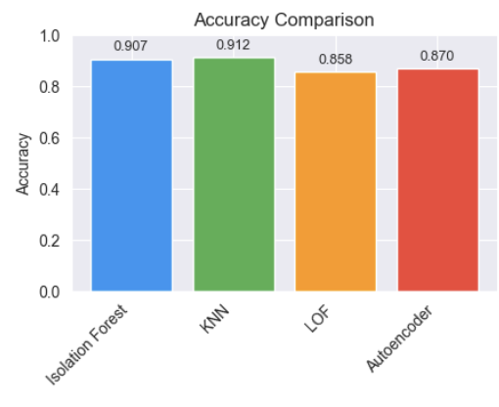
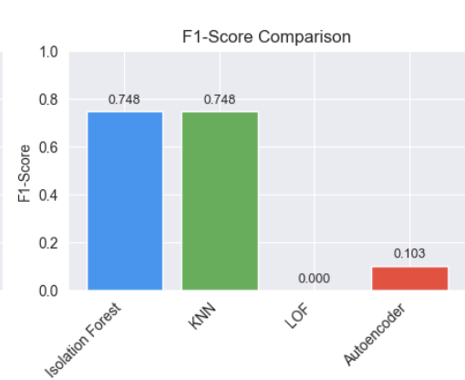
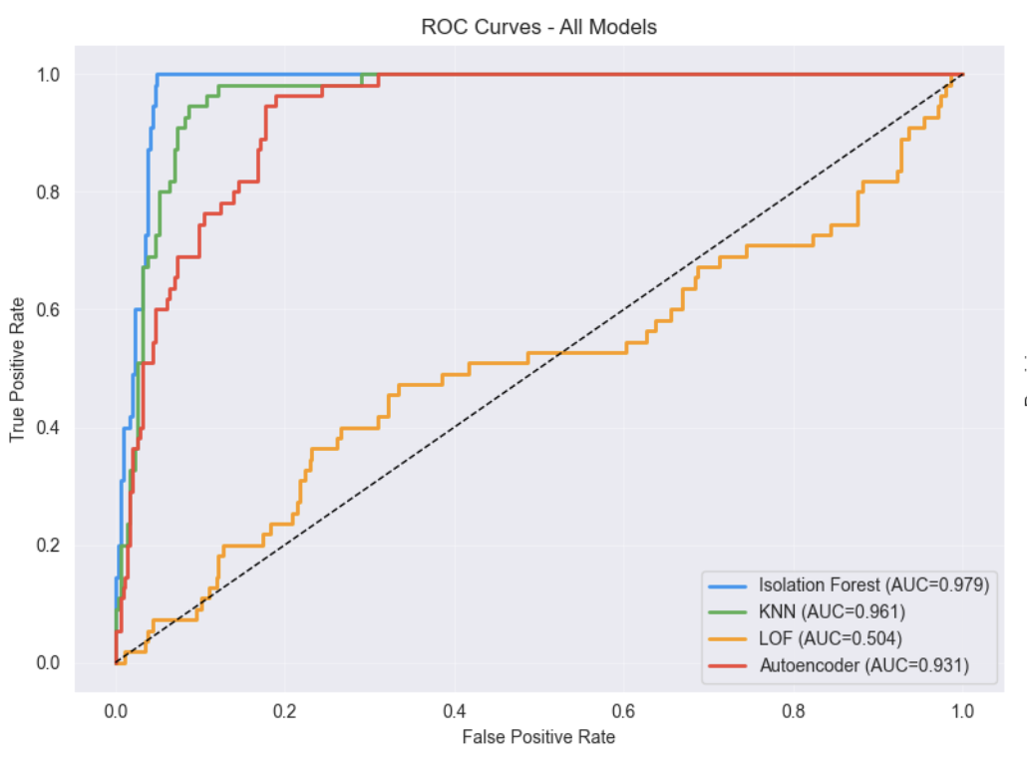
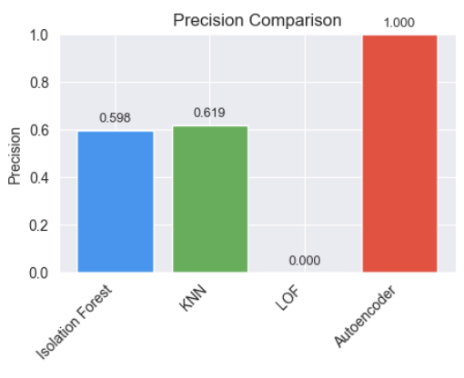
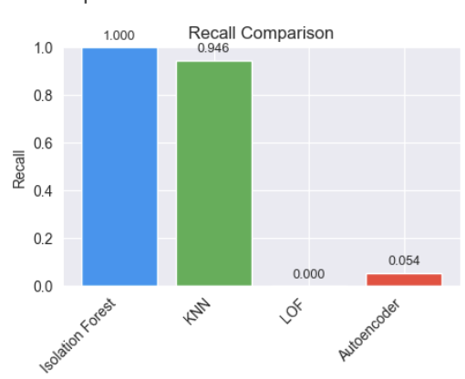
Evaluation & Validation
Metrics
Recall
Precision
F2-score
MCC
Notes:
And care results and clinical synthesis based on the performance matrix such as recalled position accuracy and F scoring isolation forest as achieved the best overall results with F1 score of 0.743 and AUCROC 0.798 The auto” provides a higher recall of 1.00 and sharing no critical medical events were miss but with a lower precision score of 0.475 which can be determined with this result screenshot

Slide 9
Clinical Decision Support (FUTURE WORK)
Case A: Physiological Emergency
Simultaneous decrease in:
SpO₂
Heart Rate
Strong coordinated SHAP contributions
Triggered: ✅ Emergency Alert
Case B: Technical Sensor Fault
Single erratic feature spike
No supporting physiological correlation
Triggered: ✅ Sensor Check Notification
Anomaly
Multi-feature change
Single noisy feature
SHAP Analysis
Emergency Alert
Sensor Check
Benefits
Reduced alarm fatigue
Improved clinician trust
Faster triage and prioritisation
More reliable monitoring
Notes:
So for clinical value synthesis this framework allows clinics to distinguish between medical anomalous and technical anomalous medical anomalous being patient level readings and technical anomalous being device sensor device error so medical anomalous have driven by a multiple physiological shifts like heart rate and SPO readings anomalous is being driven by isolations and errors of sense of behaviour network flex

Slide 10
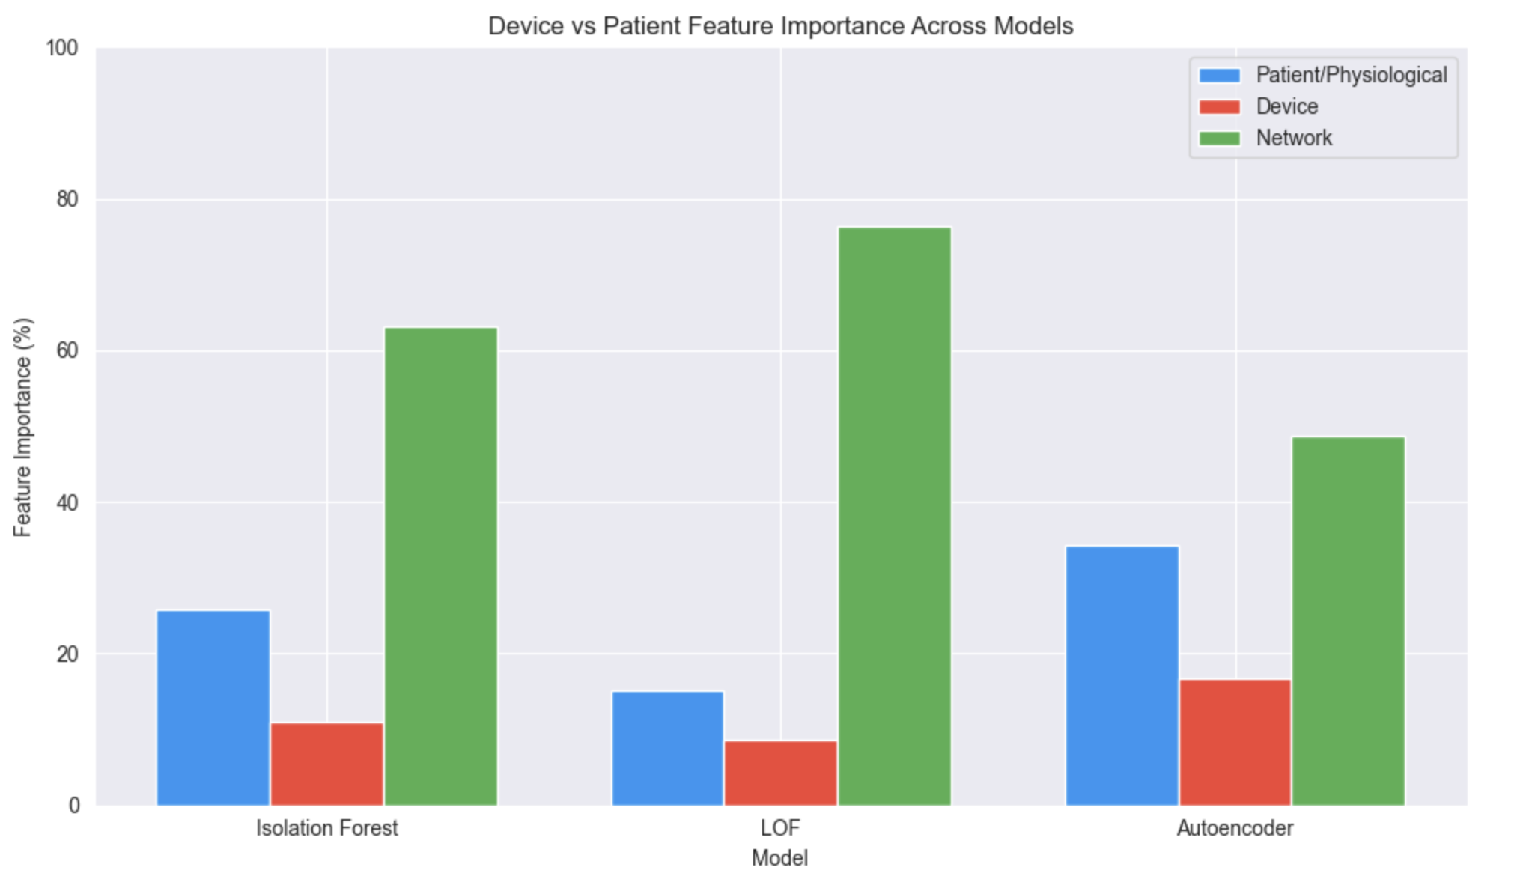
Critical Appraisal & Reflection
Strengths & Achievements
Successfully integrated:
Autoencoder anomaly detection
SHAP explainability
Improved interpretability in healthcare AI
Reduced false emergency escalation
Demonstrated strong recall for anomaly detection
Key Limitations
Kernel SHAP introduced computational overhead
High latency on resource-constrained wearable devices
LIME explanations showed instability across similar samples
Autoencoder struggled with long-term temporal dependencies
Future Work
Temporal Transformers for sequential modelling
Federated Learning for privacy-preserving healthcare AI
Tiny ML / Edge AI optimisation
Lightweight SHAP approximations
Notes:
I have successfully breached the interpretability cap by showing why a model flags anomaly from both patient data and device data which is both medical and technical but there are some limitations for these framework like SHAP has a high computational cost which may require a hybrid cloud edge deployment for accurate results, which is why I’m not able to generate and explainability outcomes for sharp other than a feature importance and also for result time variables since the data I have selected has 2000 attributes which is not possible for sharp to perform accurately in my device and requires a cloud deployment to perform accurately which will be a limitation for this framework

Slide 11
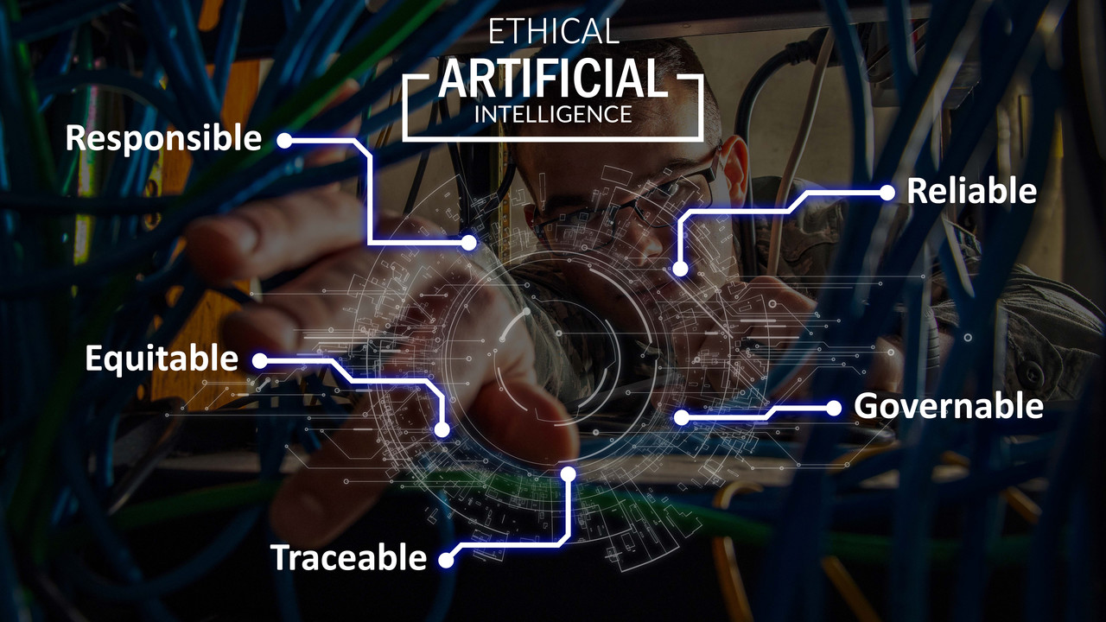
ELSS Considerations
Ethical
Automation Bias:
Risk of clinicians over-relying on AI predictions
SHAP explanations support human verification
False Negatives:
Missing critical events may endanger patients
Threshold prioritised high recall for safety
Professional
BCS Code of Conduct
Duty of Care
Public Interest
Transparency in AI systems
GDPR Compliance
Data anonymisation
Secure handling of patient information
Sustainability
Computational Cost
SHAP increases CPU and energy usage
Edge devices have battery limitations
Mitigation
Edge-cloud hybrid processing
Lightweight explainability models
Social
Alarm Fatigue Reduction
Reduced false alarms
Improved clinician efficiency
Increased trust in AI-assisted monitoring

Slide 12

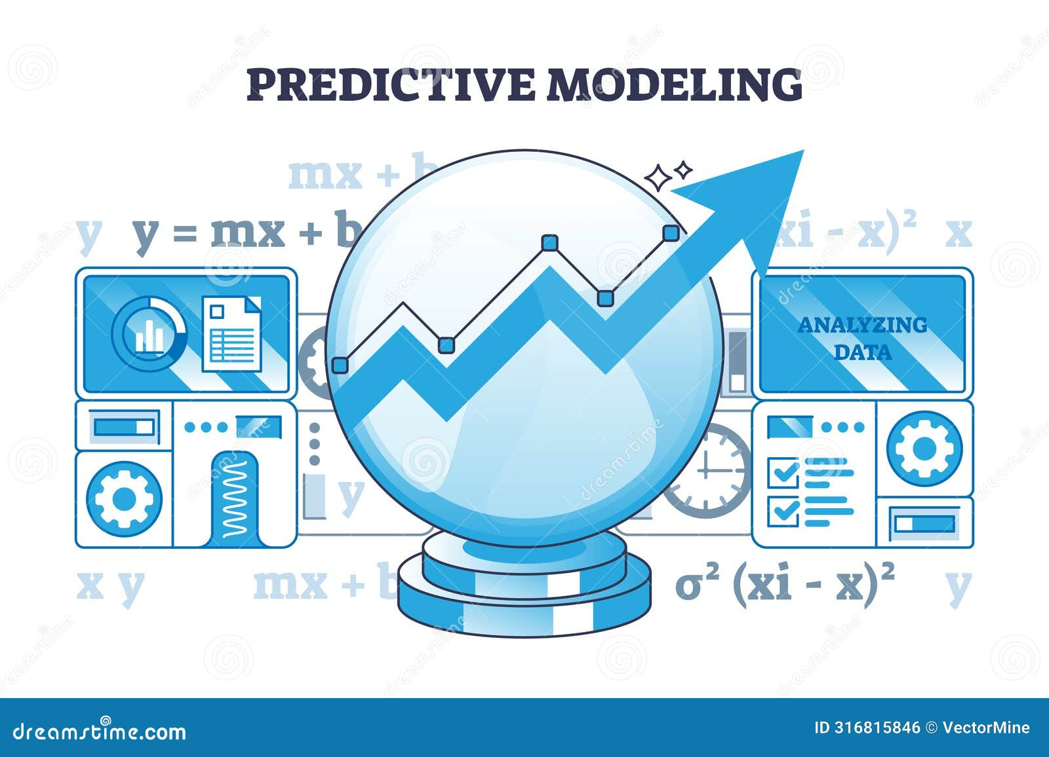
Conclusion
Developed an Explainable mIoT Anomaly Detection Framework
Autoencoder-based anomaly detection
SHAP/LIME explainability techniques
Clinical decision-support logic
Addressed the Interpretability Gap
Moved beyond “black-box” predictions
Enabled clinicians to understand:
why anomalies occur
whether alerts represent:
physiological emergencies
sensor/device faults
Improved Clinical Reliability
Reduced alarm fatigue
Prioritised high recall for patient safety
Enhanced transparency and clinician trust
Demonstrated Practical Healthcare Value
Converted raw anomaly scores into actionable medical insights
Supported proactive and context-aware monitoring in mIoT environments
This project transforms AI from a passive prediction system into a trustworthy clinical decision-support framework for next-generation healthcare monitoring.
Notes:
Explainability is not optional but fundamental requirement for safe deployment of artificial intelligence into healthcare which intern makes a trustworthy clinical decision support framework for next generation healthcare monitor

Slide 13
References
[1] Messabih, H., Kerrache, C.A., Cheriguene, Y., Amadeo, M. and Ahmad, F., 2024. Machine learning solutions for mobile internet of things security: A literature review and research agenda. Transactions on Emerging Telecommunications Technologies, 35(10), p.e5041.
[2] Rassam, M.A., Zainal, A. and Maarof, M.A., 2013. Advancements of data anomaly detection research in wireless sensor networks: a survey and open issues. Sensors, 13(8), pp.10087-10122.
[3] Moss, J., Gordon, J., Duclos, W., Liu, Y., Wang, Q. and Wang, J., 2025. Explainable AI in IoT: A Survey of Challenges, Advancements, and Pathways to Trustworthy Automation. Electronics, 14(23), p.4622.
[4] Nguyen, M.D., Bouaziz, A., Valdes, V., Rosa Cavalli, A., Mallouli, W. and Montes De Oca, E., 2023, August. A deep learning anomaly detection framework with explainability and robustness. In Proceedings of the 18th International Conference on Availability, Reliability and Security (pp. 1-7).
[5] Georgiades, M. and Hussain, F., 2025. An explainable ai approach for interpretable cross-layer intrusion detection in internet of medical things. Electronics, 14(16), p.3218.
[6] Gummadi, A.N., Abdelrahim, E.M., Gad, I. and Abdallah, M., 2025. E-RXAI-IoT: A Systematic Evaluation Framework of Rule-Based XAI Methods for Anomaly Detection in IoT Systems. IEEE Access, 13, pp.188730-188754.
[7] Nor, A.K.M., Pedapati, S.R., Muhammad, M. and Leiva, V., 2021. Explainable artificial intelligence for anomaly detection and prognostic of gas turbines using uncertainty quantification with sensor-related data.
[8] M. Janat et al., "XAI and Uncertainty Quantification for Anomaly Detection and Prognostics of Gas Turbines and Turbofans," Journal of Prognostics and Health Management, vol. 14, no. 1, 2023.
[9] M. Al-Kasassbeh, M. A. Almaiah, and A. Al-Azzam, "Evaluating Rule-Based XAI Methods for IoT Anomaly Detection: A Comprehensive Framework," IEEE Internet of Things Journal, vol. 11, no. 4, pp. 6231-6245, 2024.
[10] M. Habibi, M. Zolanvari, and A. Erbad, "Cross-Layer Intrusion Detection in IoMT using Explainable AI and Interpretability Methods," Computers & Security, vol. 142, p. 103851, 2025.
[11] S. T. Mehedi, A. Anwar, Z. Rahman, and R. Ahmed, "Deep Learning for Cybersecurity in Mobile IoT: A Survey and Taxonomy," IEEE Communications Surveys & Tutorials, vol. 25, no. 3, pp. 1852-1890, 2023.
[12] S. M. Lundberg et al., "From local explanations to global understanding with explainable AI for trees," Nature Machine Learning, vol. 2, no. 1, pp. 56-67, 2020.

